Slide 1
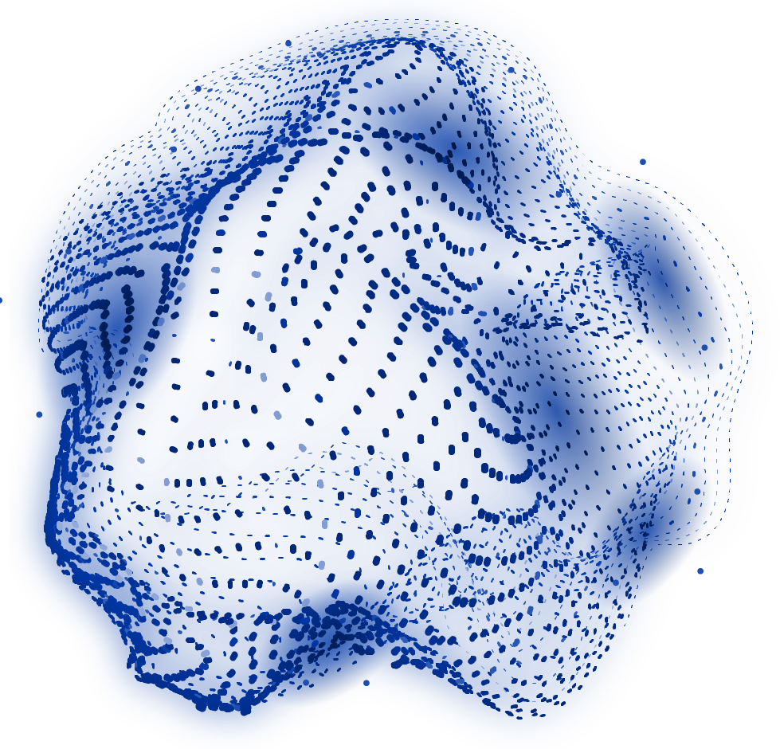


MedAssist AI
MILESTONE 3 (Recommendation Engine & Analytics Dashboard)
Dharani K

Slide 2
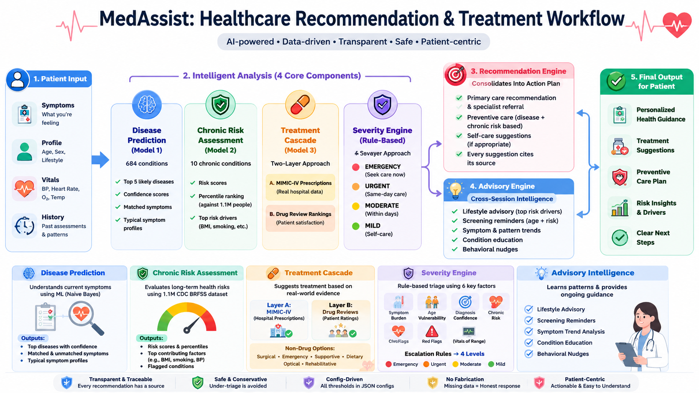

Slide 3
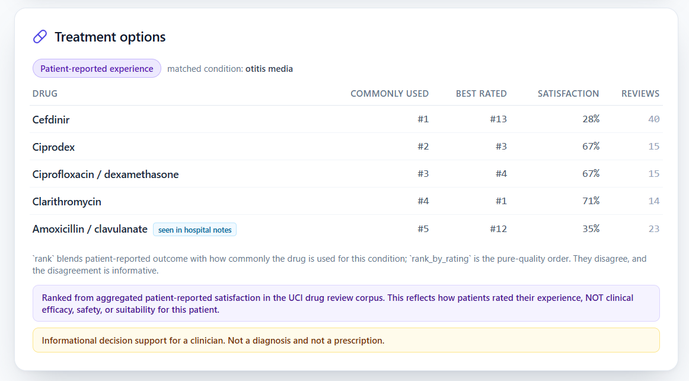
Treatment Suggestions

Slide 4
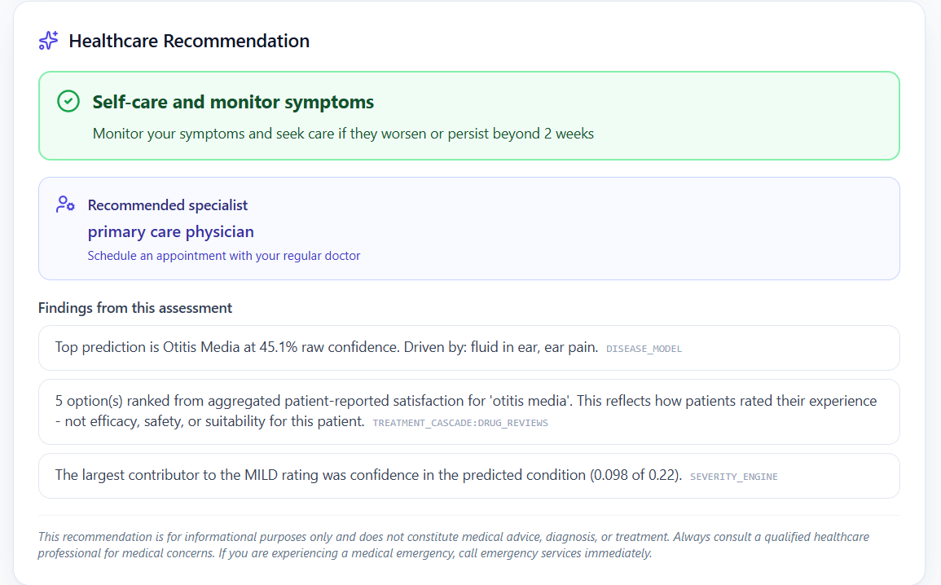
Healthcare Recommendation

Slide 5
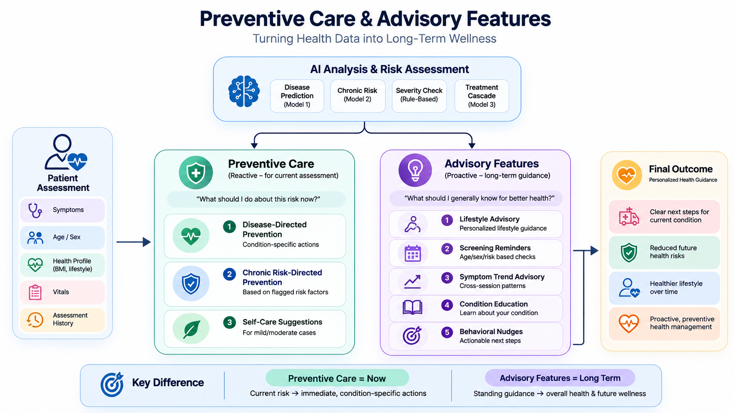

Slide 6
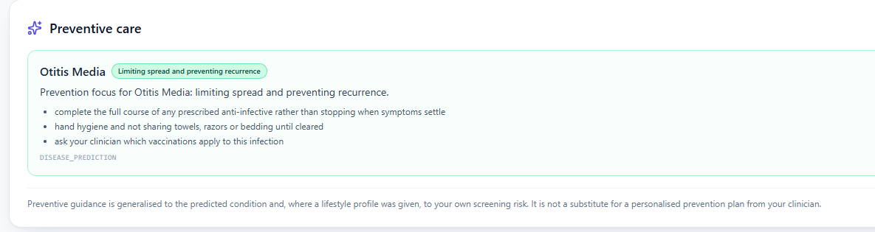
Preventive Care

Slide 7
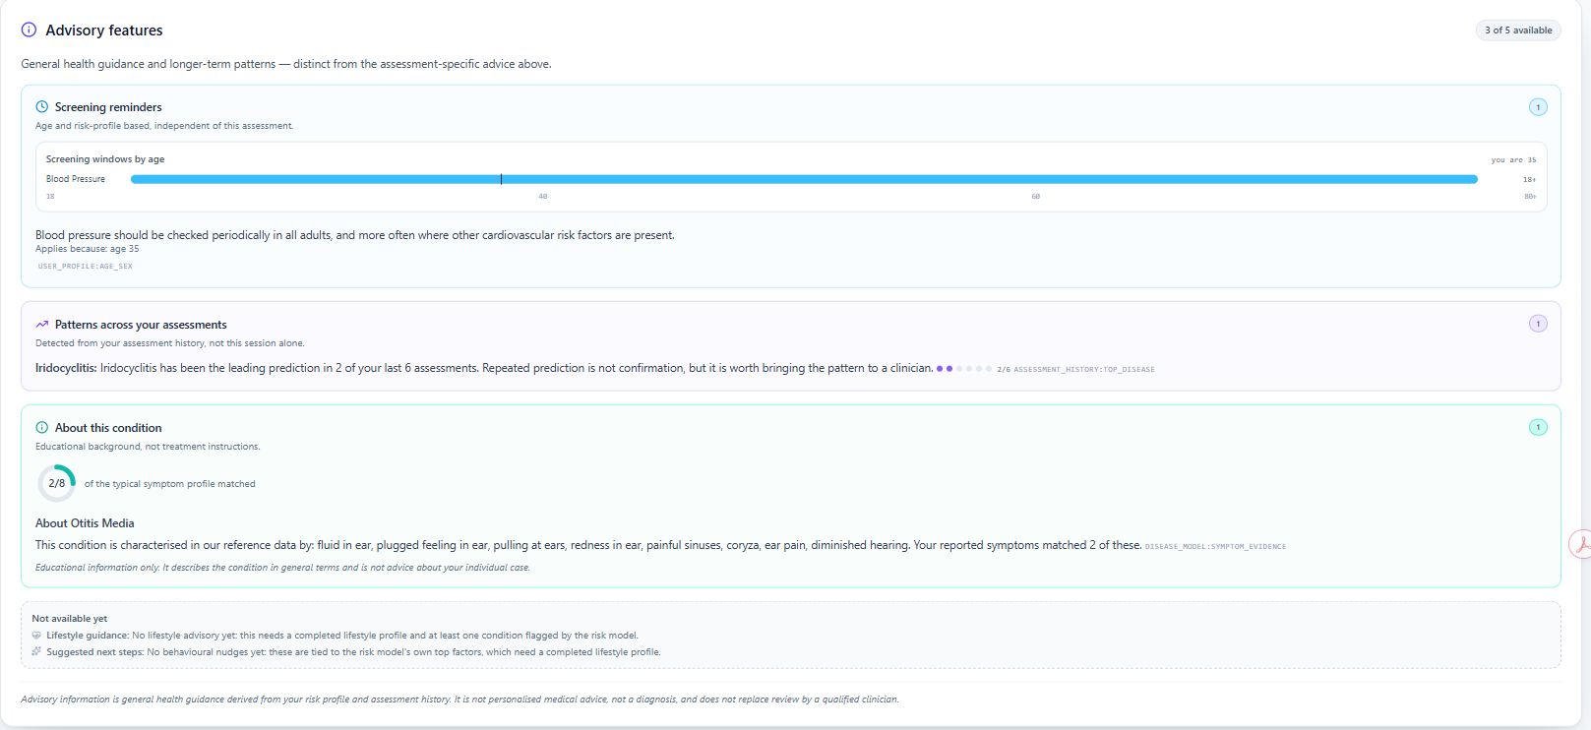
Advisory Features

Slide 8
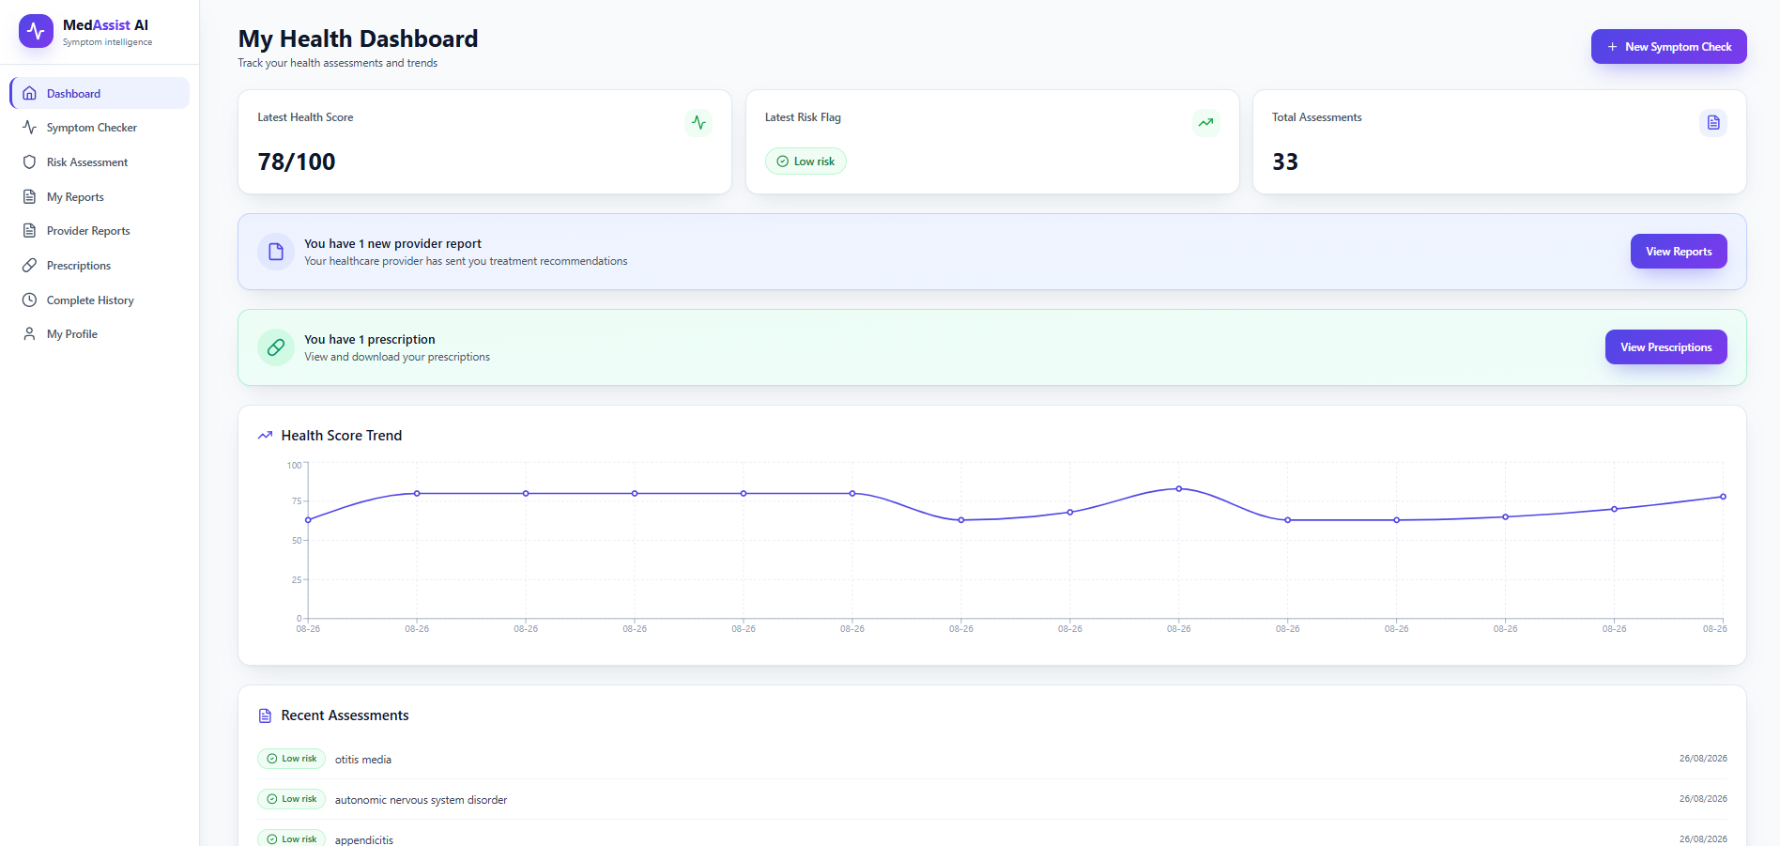
Healthcare Analytics Dashboard (Patient)

Slide 9
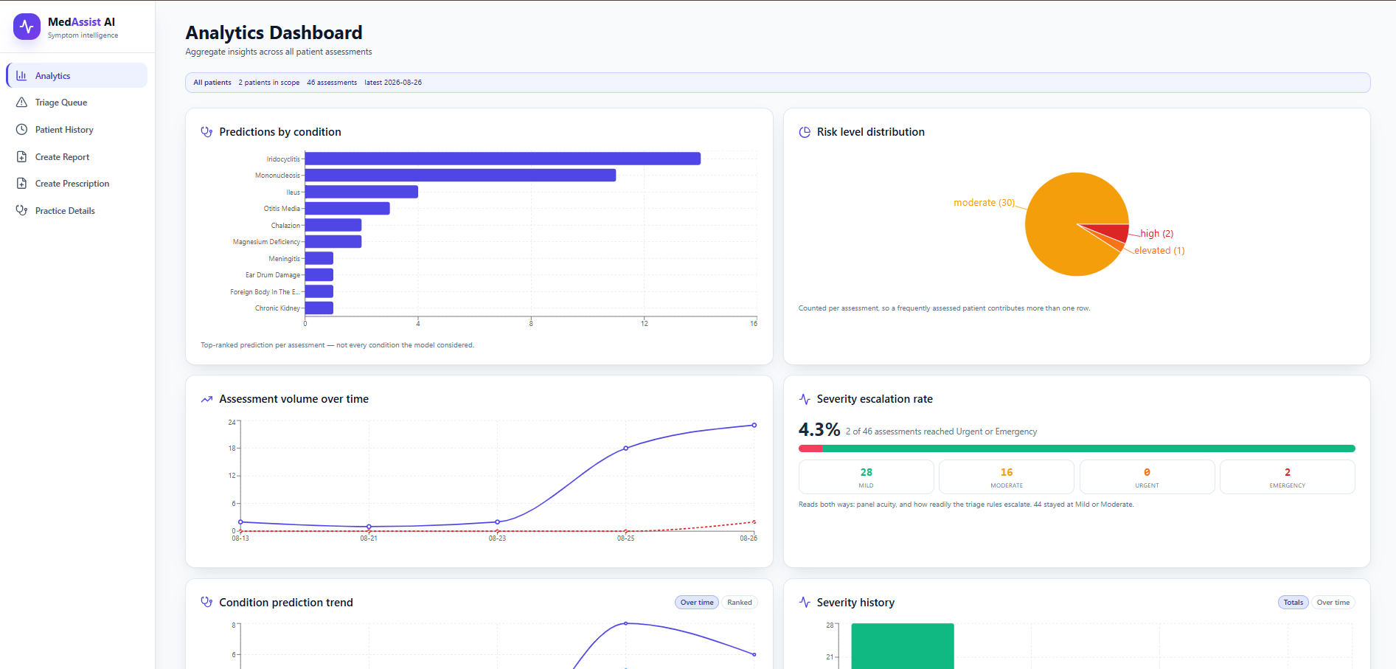
Healthcare Analytics Dashboard (Healthcare Provider)

Slide 10
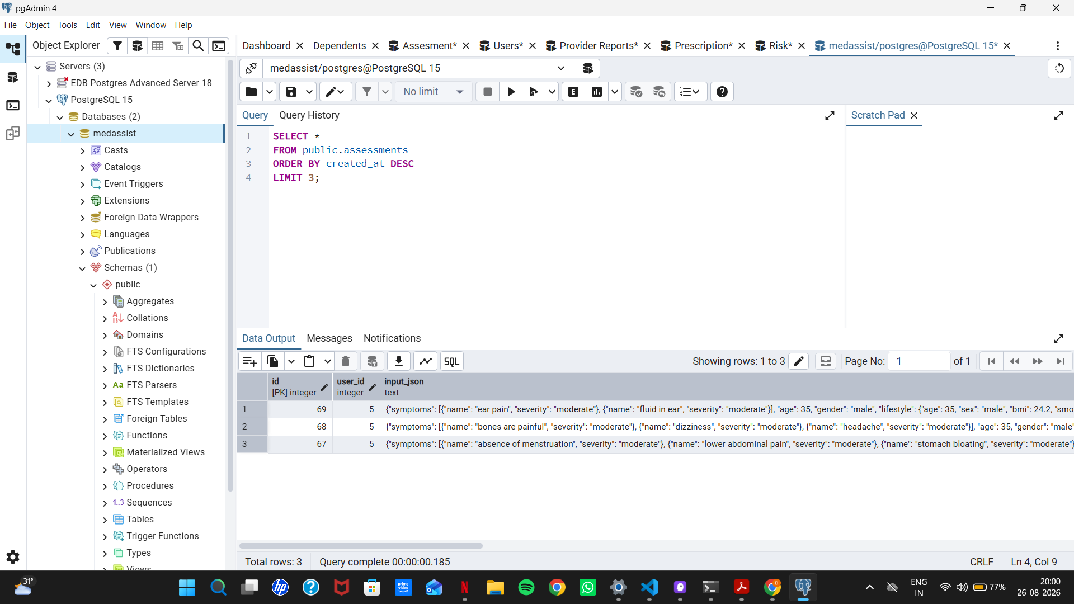
Database - PostgreSQL

Slide 11

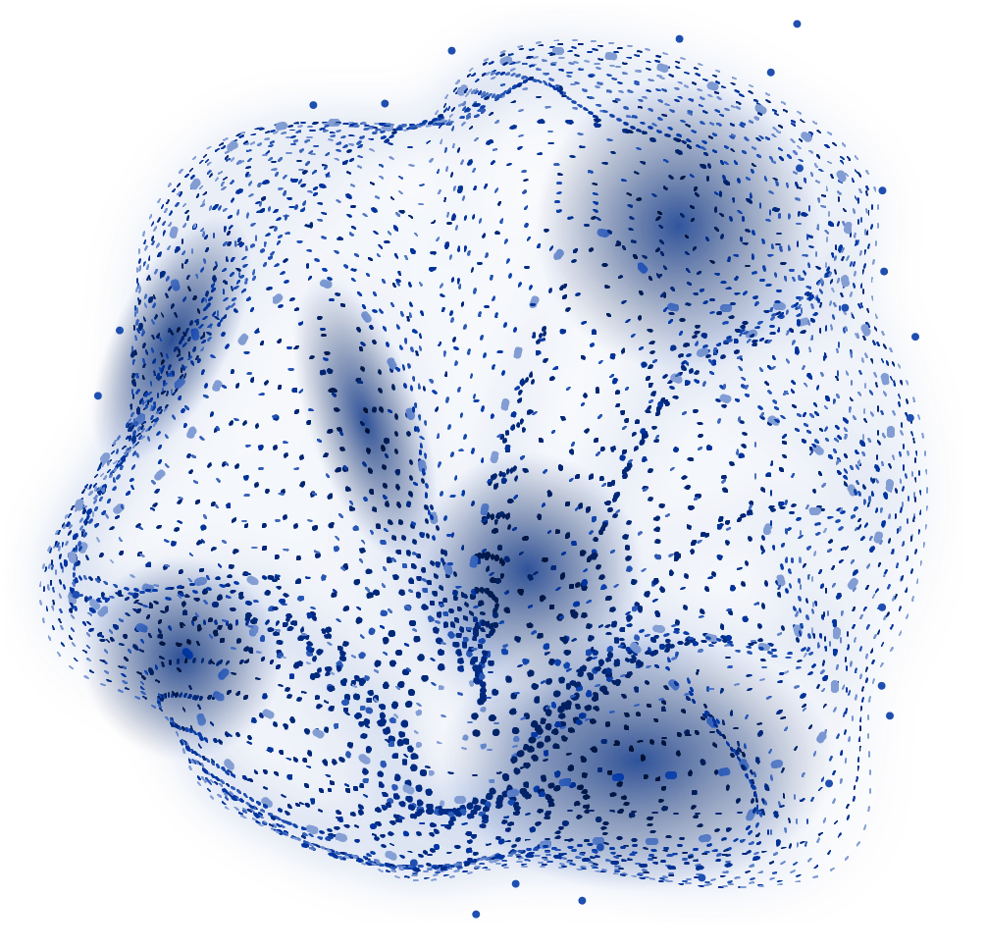
THANK
YOU!

